Slide 1
Functional Programming: A Terribly Civilised Introduction
A British Guide to Category Theory, Functors, Monoids, and Monads
WorldSMEGraphs

Slide 2

Functional Programming: A Terribly Civilised Introduction
Or: How I Learned to Stop Worrying and Love the Monad
Notes:
Open with a self-deprecating joke about how long it took you to understand this.

Slide 3

Right Then, Let's Be Honest
You're here because someone said "monads" in a meeting
And you nodded wisely whilst dying inside
Don't worry, we've all been there
(Some of us for rather longer than we'd care to admit)
Today we shall fix that. Probably. Maybe. We'll see.
Notes:
This is where you establish rapport. Everyone is confused. That's normal.

Slide 4
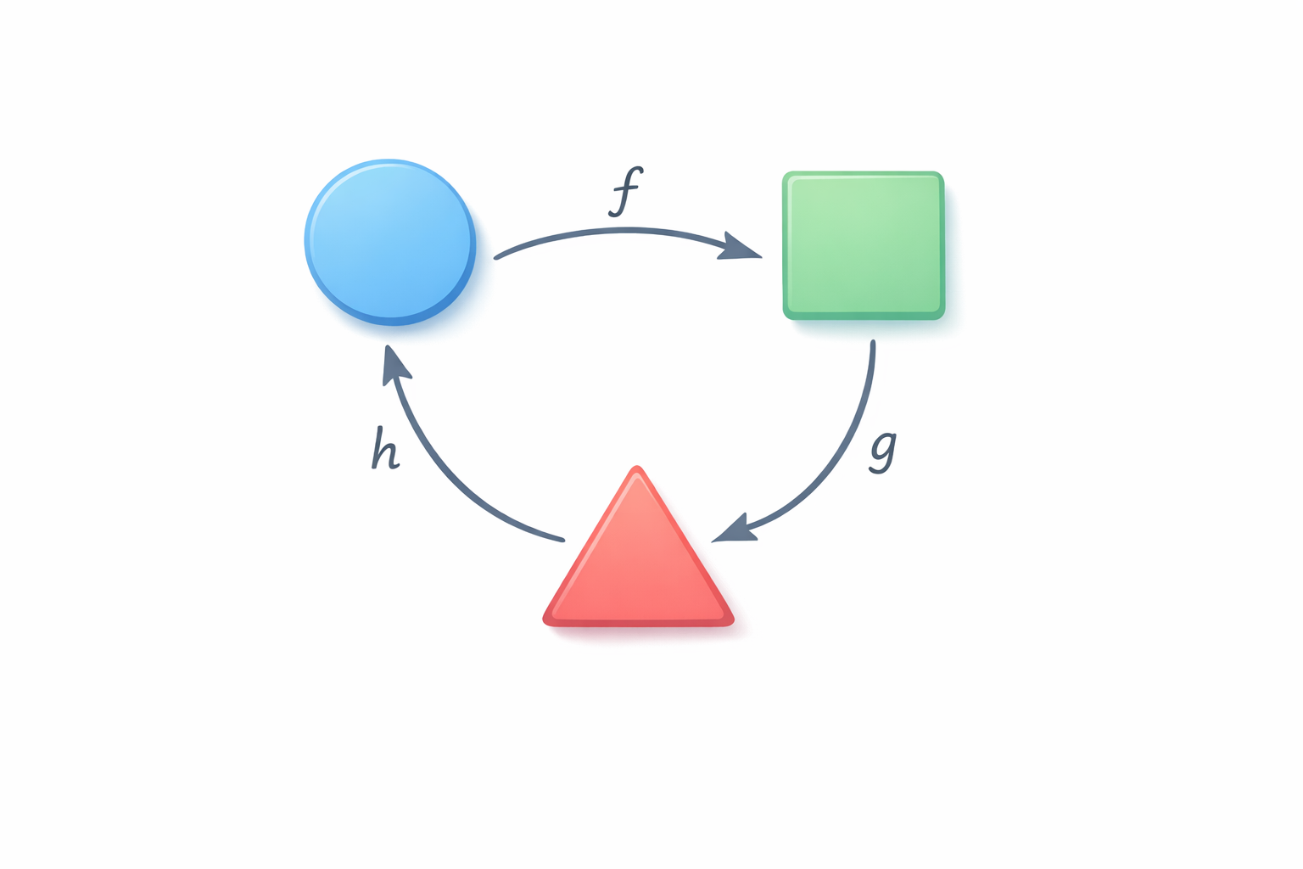
Category Theory: It's Less Scary Than It Sounds
Invented by mathematicians in the 1940s
(They needed something to do during the war besides codebreaking)
It's really just about "things" and "arrows between things"
Objects + Morphisms = That's literally it
You've been doing this all along, you just didn't know it had a fancy name
Notes:
Demystify immediately. Most developers already understand the core concepts.

Slide 5
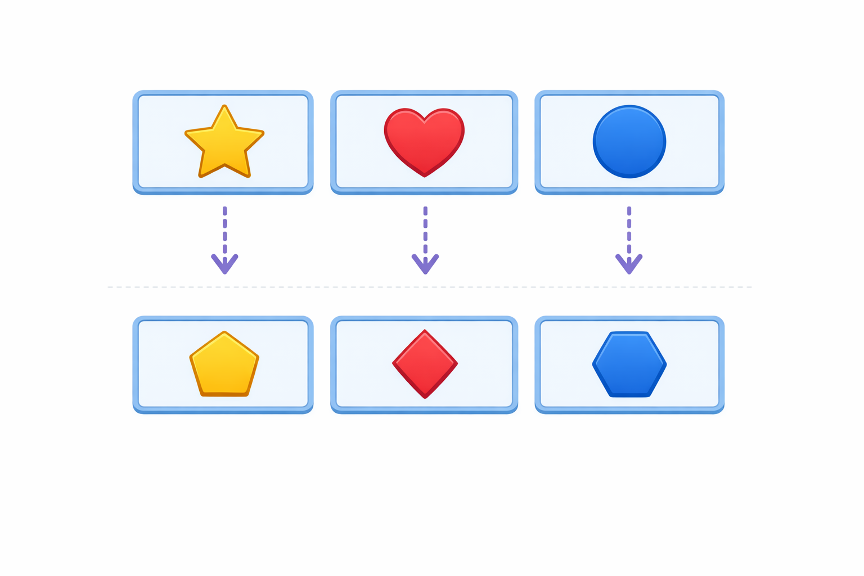
Functors: The Art of Preserving Structure
A Functor is a "structure-preserving mapping"
(In plainer English: .Select() in LINQ, .map() in JavaScript)
It takes things in boxes and transforms them whilst keeping them boxed
The box might be: List, Option, Task, Observable...
Quite useful, really. Terribly sensible.
Notes:
Connect to everyday code. Everyone uses map. Functors are just the formal name.

Slide 6
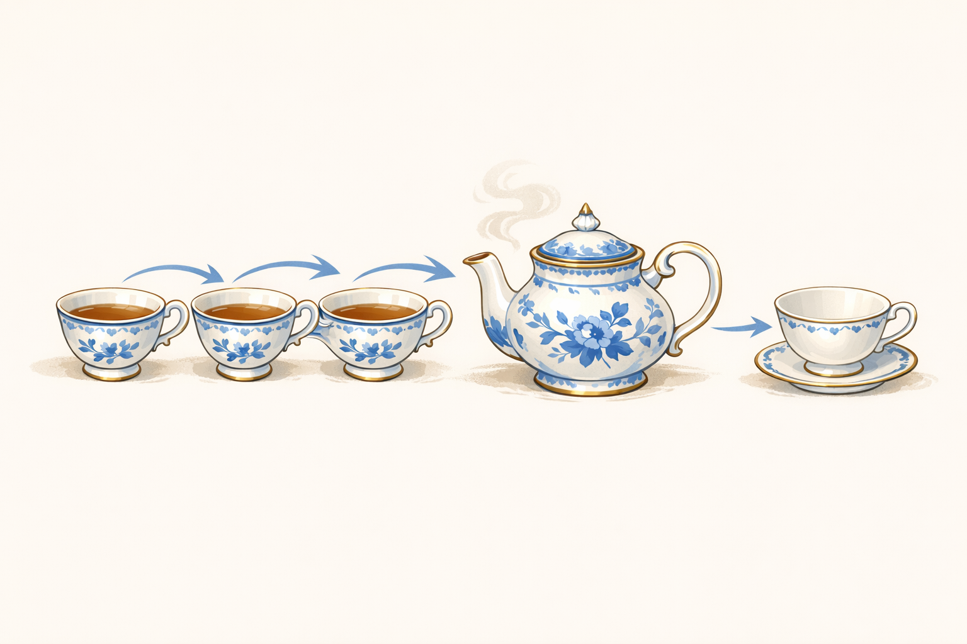
Monoids: Things That Combine Nicely
Two rules: things can be combined, and there's an "identity" thing
Numbers with addition: 1 + 2 = 3, and 0 + anything = anything
Strings with concatenation: "Hello" + "World", and "" + anything = anything
Lists: [1,2] ++ [3,4], and [] ++ anything = anything
It's like the Queen's rules of etiquette, but for data
Notes:
Monoids are everywhere. Make it click with familiar examples.

Slide 7
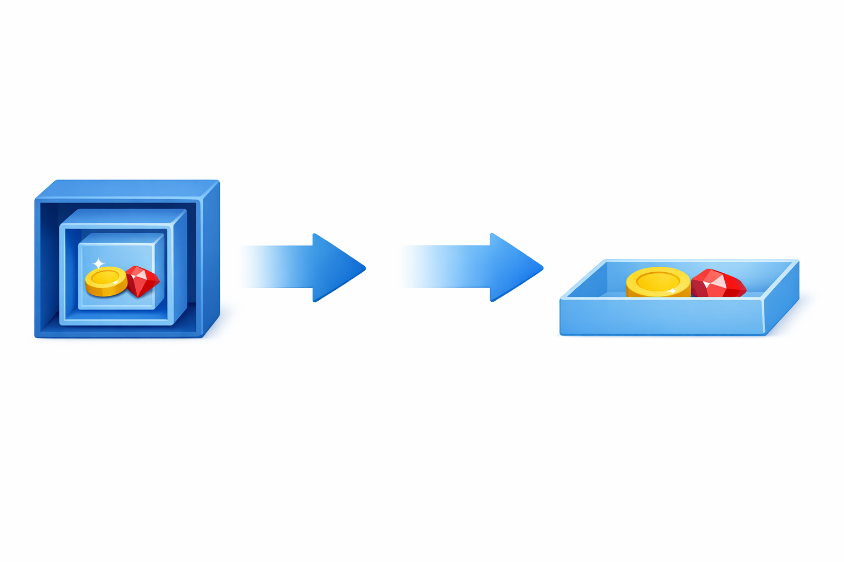
Monads: Sorry About This One
Right, deep breath. Here we go.
A Monad is a Functor that can also "flatten" nested structures
.SelectMany() in LINQ, .flatMap() in JavaScript
Promise.then() chains? That's a Monad.
Optional?.value chaining? Also a Monad.
You've been using Monads for years. Surprise!
Notes:
The big reveal. They already know this. Just didn't know the name.

Slide 8
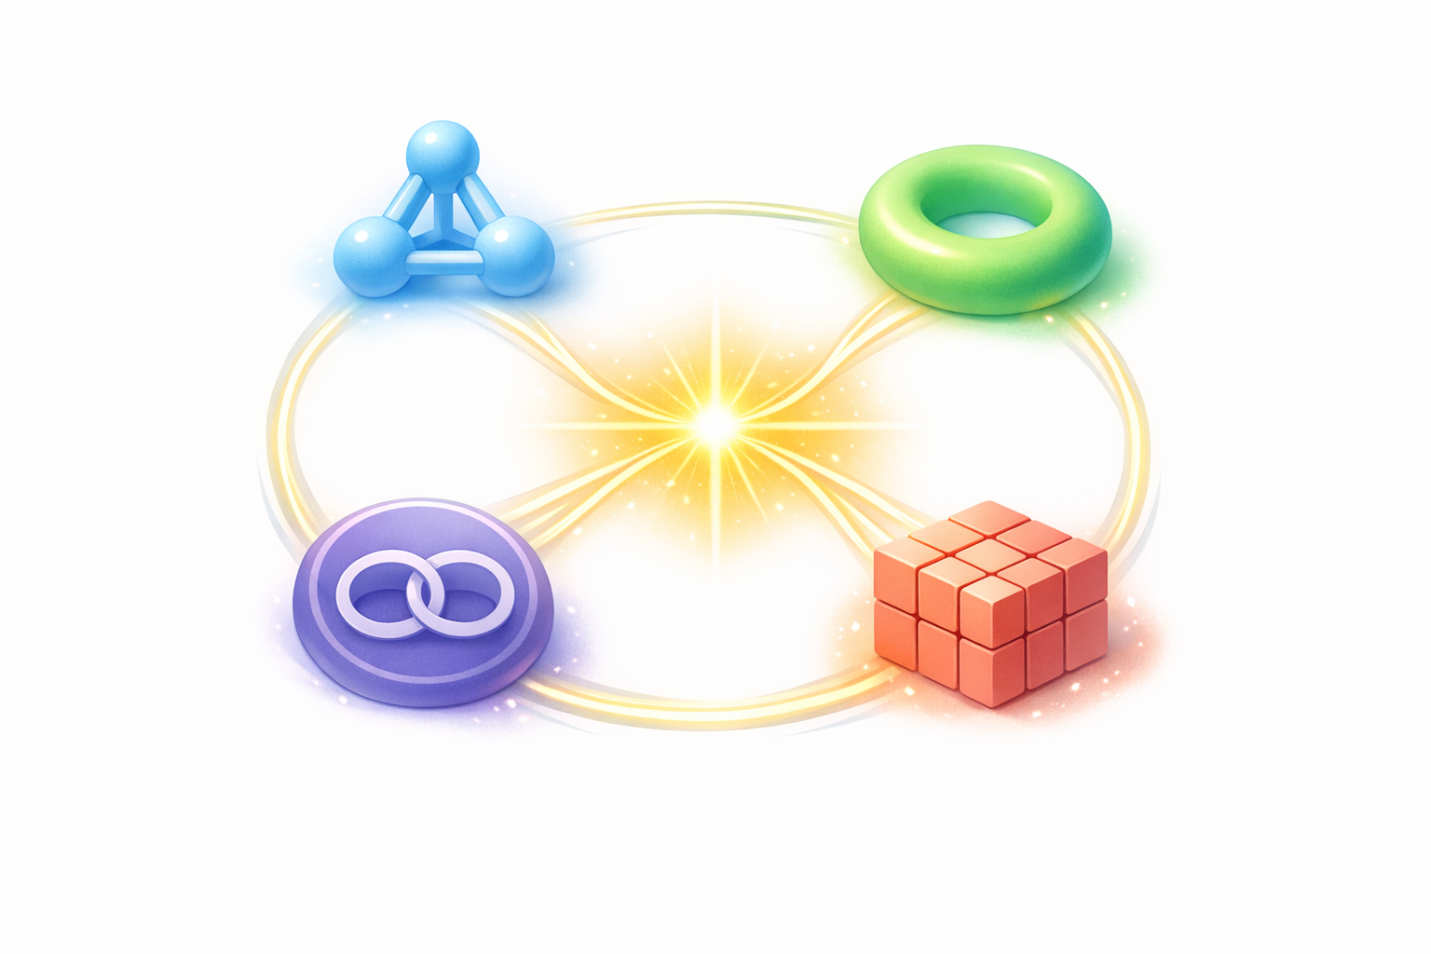
Putting It All Together (Without Panic)
Category Theory → The framework for thinking about structure
Functors → Transform contents, preserve structure
Monoids → Combine things sensibly
Monads → Functors that handle nested complexity
Together: A complete vocabulary for composition
Like LEGO, but for your code. Rather satisfying, actually.
Notes:
Tie it all together. This is the 'aha' moment.

Slide 9

What to Actually Do With This
Use .map() and .flatMap() with confidence now
Recognize patterns: "Ah, that's a Functor situation"
Compose small functions into larger pipelines
Handle errors with Either/Result types (Monads!)
Impress colleagues with restrained accuracy
Make better tea. (That last one is optional but recommended.)
Notes:
Actionable items. Send them off with something practical.

Slide 10

Any Questions?
(Besides "Why did this take so long to explain?")
Perfectly reasonable to still feel slightly confused
Rome wasn't built in a day, and neither was Haskell comprehension
Resources for further reading in the appendix
Feel free to pretend you understood everything. We won't tell.
Notes:
Open for Q&A. Have backup jokes ready for awkward silences.

Slide 11

Thank You for Your Patience
You've been a wonderful audience.
Now go forth and map things!
🍵 ☕ 🫖
Notes:
Wrap up warmly. Thank the audience genuinely.

